Slide 1
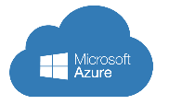

Architecting Microsoft Azure Solutions Operations
Mohd Mishal
Clouds Consultant | MCT
Notes:
http://aka.ms/certification/70-534
https://mslibrary.measureup.com/

Slide 2
Design for Operations (10-15%)
Design an application monitoring and alerting strategy
Determine the appropriate Microsoft products and services for monitoring applications on Azure; define solutions for analyzing logs and enabling alerts using Azure Log Analytics; define solutions for analyzing performance metrics and enabling alerts using Azure Monitor; define a solution for monitoring applications and enabling alerts using Application Insights
Design a platform monitoring and alerting strategy
Determine the appropriate Microsoft products and services for monitoring Azure platform solutions; define a monitoring solution using Azure Health, Azure Advisor, and Activity Log; define a monitoring solution for Azure Networks using Log Analytics and Network Watcher service; monitor security with Azure Security Center
Design an operations automation strategy
Determine when to use Azure Automation, Chef, Puppet, PowerShell, Desired State Configuration (DSC), Event Grid, and Azure Logic Apps; define a strategy for auto-scaling; define a strategy for enabling periodic processes and tasks
Notes:
https://www.microsoft.com/en-us/learning/exam-70-535.aspx

Slide 3
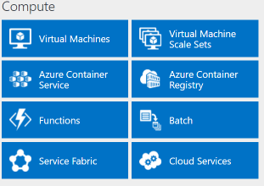
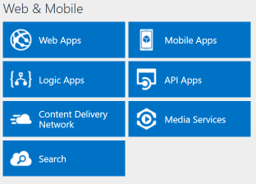
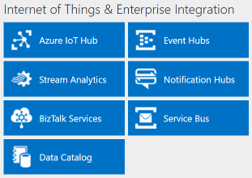
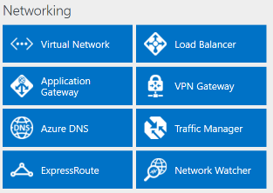
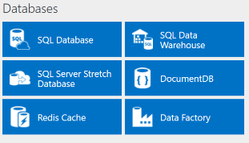
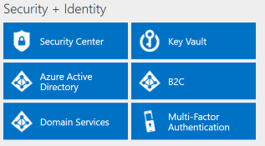
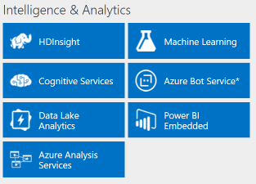
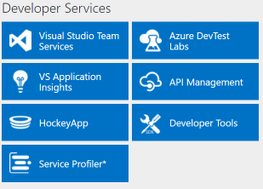
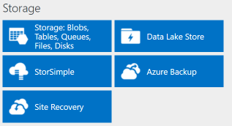
http://azureplatform.azurewebsites.net/
* Preview Services
Notes:
Preview Version 1.7 (2017-04-20)

Slide 4
Azure is a cloud partnership
Your Organization
Balance of responsibility
Cloud architectures
Design for high-availability
Leverage Microsoft resources
MICROSOFT RESOURCES
Service resiliency guide
Cloud dev patterns & practices
Proactive and reactive support
CLOUD PLATFORM RELIABILITY
Availability, change orchestration, monitoring, communications, recommendations

Slide 5
Monitoring and Alerting
Azure Monitor
Azure Advisor
Azure Resource Health
Native monitoring and diagnostics for all your Azure resources
Monitor, diagnose, alert, and be notified of events in your cloud infrastructure
Personalized recommendation guide helping you follow best practices
Optimize across four areas -high availability, performance, security, and cost
Diagnose and get support when an Azure issue impacts your resources
Guides you through solutions to mitigate issues with Azure resources
https://aka.ms/azmonitor/
http://aka.ms/azureadvisor/
http://aka.ms/azureresourcehealth/

Slide 6

Design an application monitoring and alerting strategy

Slide 7

What does visibility mean to you?
Diagnose problems across my app, VMs, networks, and PaaS services
Show exec dashboards of application SLAs & KPIs
Understand & optimize performance of my app
Track usage, engagement & retention of my app
Detect & debug the errors in my apps
Is there is a security threat!!!!!
Notes:
Monitoring means different things to different people. While you might be focused just on application monitoring, there are cases where you might want to also look at infrastructure & platform for correlations, and that is where “Azure Monitoring & Analytics” provides an integrated consolidated solution.

Slide 8
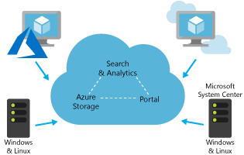
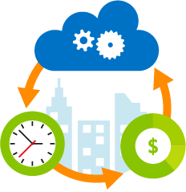
Log Analytics
Collect and correlate data from multiple sources
Collect and analyze Azure activity logs
Customize dashboards to focus on what matters most to you
Perform rich data exploration with interactive queries
Use smart analytics powered by machine learning
Turn insights into action with built-in notification and automation
Notes:
Transform your log data into insights and action
Quickly connect and collect log data from multiple sources
Correlate and analyze using powerful machine learning constructs
Search and query interactively using an expressive language
Develop deep insights using purpose-built management solutions
formerly known as OMS Log Analytics, is an Azure service that ingests log and metric data from Azure services (via Azure Monitor), Azure VMs, and on-premises or other cloud infrastructure and offers flexible log search and out-of-the box analytics on top of this data. It provides rich tools to analyze data across sources, allows complex queries across all logs, and can proactively alert on specified conditions. You can even collect custom data into its central repository so you can query and visualize it. You can also take advantage of Log Analytic's built-in solutions to immediately gain insights into the security and functionality of your infrastructure.

Slide 9
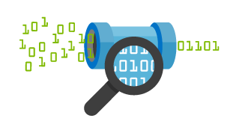
Azure Monitor
View and manage all your monitoring data easily
Set up alerts and take automated actions
Diagnose operational issues quickly
Integrate with your existing tools
Notes:
Get the granular, up-to-date monitoring data you need—all in one place
Monitor your Azure resources with detailed logs
Set up alerts and take proactive, automated actions
Use flexible configuration and data consumption options
Integrate with analytics and notification tools familiar to you
the Azure service that operates as a consolidated pipeline for all monitoring data from Azure services. It gives you access to performance metrics and events that describe the operation of the Azure infrastructure and any Azure services you are using. Azure Monitor is a monitoring data pipeline for your Azure environment, and offers that data directly into Log Analytics as well as 3rd party tools where you can gain insight into that data and combine it with data from on premises or other cloud resources.

Slide 10
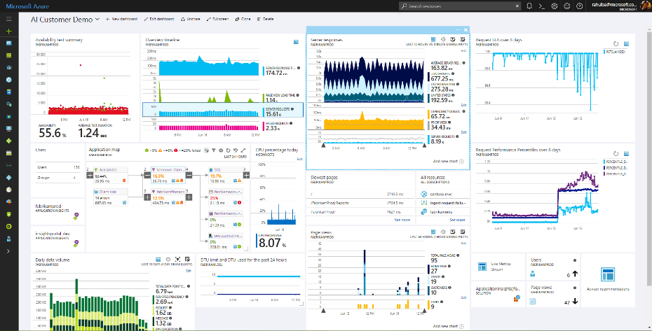
Azure Application Insights
Health Check
Monitor & Optimize
Detect & Debug
Data Analytics
Take Actions
Export & Correlate
DevOps Workflows
Customer Insights
Notes:
Get actionable insights through application performance management and instant analytics
Detect and diagnose exceptions and application performance issues
Monitor Azure websites, including those hosted in containers, plus websites on-premises and with other cloud providers
Seamlessly integrate with your DevOps pipeline using Visual Studio Team Services, GitHub, and our webhooks
Get started from within Visual Studio, or monitor existing apps without redeploying

Slide 11






Application Insights Ecosystem
Ingestion
Exploration
Export & Correlation
Application Insights
Microsoft Azure Portal
OMS Connector
Power BI
Open Source SDKs
Status Monitor
Azure Extensions
Azure Monitor
Application Map
Live Metrics Stream
Profiler & Debugger
Microsoft Azure dashboards
Blob storage
Visual Studio Team Services
SCOM MP Open Schema
Visual Studio IDE
Analytics Portal
Data Access APIs
Support
ASP.NET
ASP.NET Core
Java - J2EE
Windows Desktop
WCF
JavaScript
Node.JS
PHP
Python
Ruby
Angular
Docker
Kubernetes
Dynamics CRM
Azure Web Apps
Azure Cloud Services
Azure VMs
Azure Functions
Azure Service Fabric
Glimpse
Spring
Log4Net/NLog
Log4J/Logback
System.Diagnostics
Semantic Logging (SLAB)
ETW/EventSource
LogStash
Collectd
Concrete
Drupal
Joomla
SharePoint
WordPress
Orchard
OSS/Public Endpoints
…

Slide 12
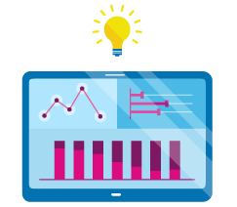
Design a platform monitoring and alerting strategy

Slide 13
Full set of cloud management capabilities
GOVERN
SECURE
Policy Management
Cost Management
Security Management
Threat Protection
CONFIGURE
Microsoft Azure
PROTECT
Configuration
Update Management
Automation
Scripting
Backup
Disaster Recovery
MONITOR
App, Infra, & Network Monitoring
Log Analytics and Diagnostics
Notes:
Talk through the investments of what MSFT/Azure sees as important for enterprise cloud management platform
The combination together is powerful. Truly integrated capabilities SaaS management and security.
To be successful in the Cloud era, enterprises must have visibility/metrics and controls on every component to pinpoint issues efficiently, optimize and scale effectively, while having the assurance the security, compliance and polices are in place to ensure the velocity.
Native Security and Management in Azure
Enterprise grade capabilities natively from the cloud provider Azure
Integrated and interconnected across data and experiences
Management capabilities included with the flexibility to increase or choose 3rd party
Can make the point that for those familiar with OMS these were the foundation for what we now have natively within Azure.
5 main areas:
Secure: While Azure is trusted and secure platform, you as a customer have your own security settings you need to manage. You also need to be able to protect your individual machines against threats and monitor the security posture of your system.
Protect: Your VMs and applications in the cloud need to be backed up and protected in the event of data loss. With disaster recovery from on-prem to the cloud, or from one cloud to another, you can avoid downtime and keep your applications up and running.
Monitor: Every operations manager and every developer needs to be able to see the health and performance of their applications, infrastructure, and network. And seeing insights across all three together in a single dashboard can save time and resources in troubleshooting and preventing issues in the future.
Configure: For managing Azure and hybrid workloads at scale, automation and configuration capabilities help you create runbooks to automate tasks, manage the configuration settings and track changes, and monitor and deploy missing updates. Additionally in Azure you can use PowerShell and Cloud Shell for command line scripting.
Govern: Many customers need a way to look across cloud resources to assess and enforce enterprise-wide standards and policy compliance for security and management. In addition, they need to manage and monitor costs for the cloud. We recently acquired Cloudyn, a multi-cloud cost management solution to help our customers with this challenge.

Slide 14
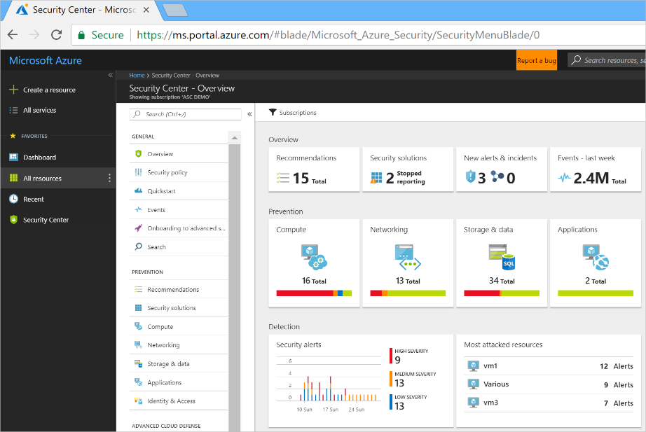
https://docs.microsoft.com/en-us/azure/security-center/security-center-intro
Notes:
https://docs.microsoft.com/en-us/azure/security-center/security-center-intro
Centralized policy management – Ensure compliance with company or regulatory security requirements by centrally managing security policies across all your hybrid cloud workloads.
Continuous security assessment – Monitor the security of machines, networks, storage and data services, and applications to discover potential security issues.
Actionable recommendations – Remediate security vulnerabilities before they can be exploited by attackers with prioritized and actionable security recommendations.
Advanced cloud defenses – Reduce threats with just in time access to management ports and whitelisting to control applications running on your VMs.
Prioritized alerts and incidents - Focus on the most critical threats first with prioritized security alerts and incidents.
Integrated security solutions - Collect, search, and analyze security data from a variety of sources, including connected partner solutions.

Slide 15
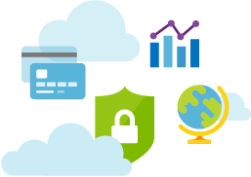
Azure Advisor
Improve what matters most
Get ongoing, actionable advice
Implement recommendations easily
Notes:
Your personalized recommendation guide to Azure best practices
Optimize your Azure resources for high availability, security, performance, and cost
Implement personalized recommendations with ease
Access best practice optimizations at no additional cost
Advisor is a personalized cloud consultant that helps you follow best practices to optimize your Azure deployments. It analyzes your resource configuration and usage telemetry and then recommends solutions that can help you improve the cost effectiveness, performance, high availability, and security of your Azure resources.+
With Advisor, you can:
Get proactive, actionable, and personalized best practices recommendations.
Improve the performance, security, and high availability of your resources, as you identify opportunities to reduce your overall Azure spend.
Get recommendations with proposed actions inline.

Slide 16
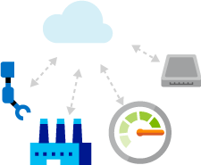


Network Watcher
Automate remote network monitoring with packet capture
Gain insight into your network traffic using flow logs
Diagnose VPN connectivity issues
Notes:
Monitor, diagnose, and gain insights to your network performance and health
Remotely capture packet data for your virtual machines
Monitor your virtual machine network security using flow logs and security group view
Diagnose your VPN connectivity issues
Network Watcher provides the following features: • Topology • Variable Packet Capture • IP Flow Verify • Next Hop • Diagnostics Logging • Security Group View • NSG Flow Logging • VPN Gateway Troubleshooting • Network Subscription Limits • Role Based Access Control • Connectivity

Slide 17








Architecture
THREAT
INTELLIGENCE
AZURE
NETWORK & PAAS Netflow, SQL DB and Storage Logs, …
AZURE SECURITY CENTER
SECURITY ANALYTICS
Threat Detections, Prescriptive Recommendations
Security Dashboards Deliver Rapid Insights into Security State Across All Workloads
Security Dashboards Deliver Rapid Insights into Security State Across All Workloads
WINDOWS & LINUX AGENTS
Windows Events, Syslog, CEF, Configurations
Actionable Security Recommendations
NORMALIZATION & ENRICHMENT IP Geotagging, …
SCALABLE LOG ANALYTICS
PLATFORM
Curated, Prioritized Security Alerts
ON-PREMISES, PRIVATE AND PUBLIC CLOUDS
Investigation Tools and Log Search
Export to Excel and Power BI
API
REST APIs
Automation
Notifications

Slide 18
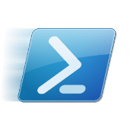
Design an operations automation strategy
Notes:
Azure Automation provides a way for users to automate the manual, long-running, error-prone, and frequently repeated tasks that are commonly performed in a cloud and enterprise environment. It saves time and increases the reliability of regular administrative tasks and even schedules them to be automatically performed at regular intervals. You can automate processes using runbooks or automate configuration management using Desired State Configuration.

Slide 19


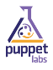
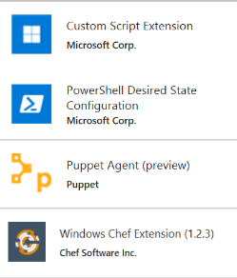
Azure Automation
Azure Automation
Runbooks
Chef Configure and Automate. Apply Fine Grained Permissions
https://www.chef.io/solutions/windows/
Puppet Can Configure and Manage Windows and Azure
http://puppetlabs.com/solutions/microsoft
Desired State Configuration
Make it So https://docs.microsoft.com/en-us/azure/automation/automation-dsc-overview
In the portal + New – Azure Automation
DevOps Enabler
Others, Docker, Ansible, SaltStack, etc.

Slide 20
Which to use? All can be used with Windows & Linux
Chef
If you already have a Chef management infrastructure
If your primary expertise is managing Linux machines
Puppet
If you already have a Puppet management infrastructure
If your primary expertise is managing Linux machines
DSC
If you do not already have a Configuration Management Solution
If your primary experience is in managing Windows machines
Uses vender-neutral configuration files (MOF)
If you already have PowerShell expertise
Azure Automation
If you do not already have a Configuration Management Solution, or not deeply embedded
If you want to significantly expand your configuration management without significant expense
If you already own OMS
If you already have PowerShell expertise

Slide 21
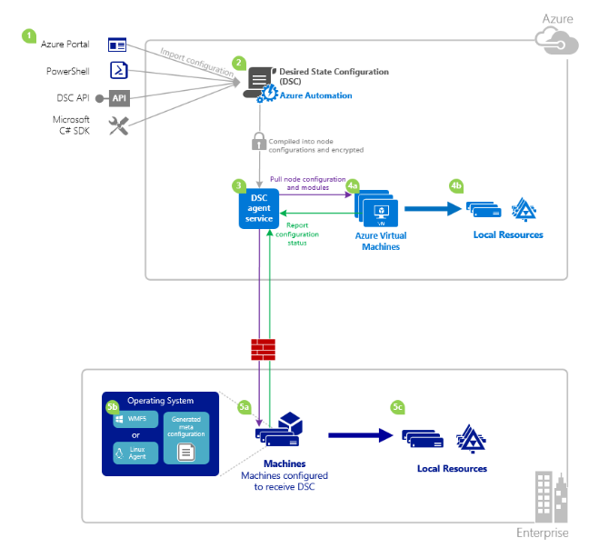
Desired State Configuration (DSC)
Notes:
Install or remove windows roles and features
Running Windows PowerShell scripts
Managing registry settings
Managing files and directories
Starting, stopping, and managing processes and services
Managing groups and user accounts
Deploying new software
Managing environment variables
Discovering the actual confi guration state on a given node
Fixing a confi guration that has drifted away from the desired state

Slide 22
Chef & Puppet
Chef
Cross-OS systems management, automation, and analytics output
Ruby and Git are required + agent is on target machine
Good for development focused teams (code driven approach to configuration)
Leverage Chef in Azure when already using it.
Puppet
Stable and mature so good for managing large, heterogeneous enterprise environments
Automate systems configuration & enforce consistency
Large Open Source catalog of modules and runs on nearly every OS (cross platform)

Slide 23
Azure Event Grid
Fully-managed event routing
Near real-time event delivery at scale
Broad coverage within Azure and beyond
Backbone of event-driven computing

Slide 24
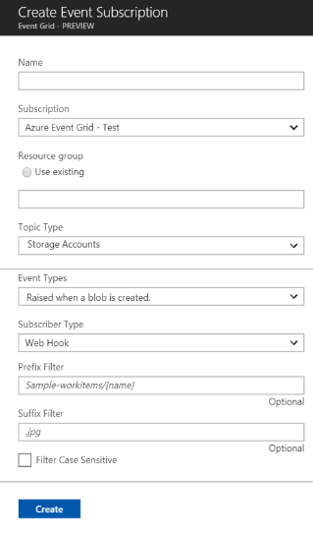


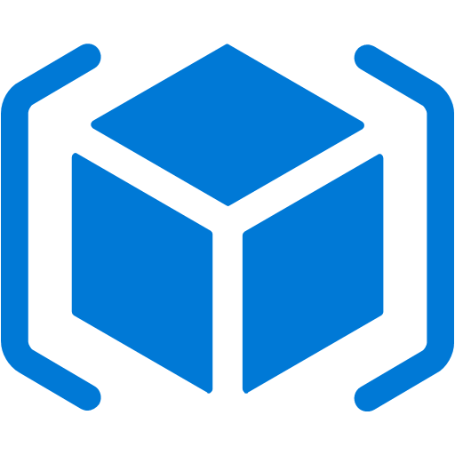
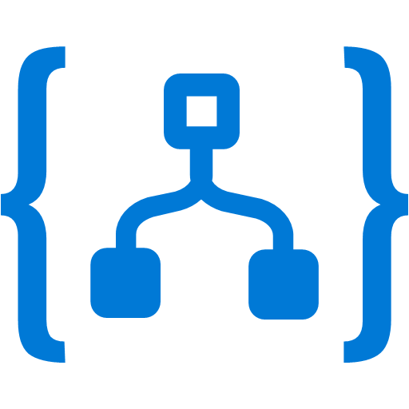


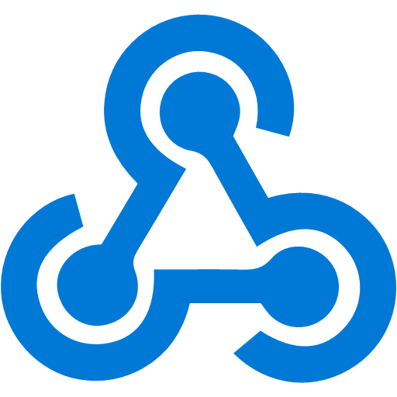
Manage all events in one place
Event publishers
Event handlers
Blob Storage
Azure Functions
Resource Groups
Subscribe to pre-defined system events in Azure or create your own custom topics
Logic Apps
Azure Subscriptions
Route events to any end-points, Azure or even beyond
Azure Automation
Event Hubs
WebHooks
Custom Events
Enable filtering and efficient routing of events
Notes:
Near Real Time
Sub-second end-to-end latency in the 99th percentile
Massive Scale Out
10,000,000 events per second per region
Highly Reliability
24-hour retry with exponential back off for events not delivered

Slide 25
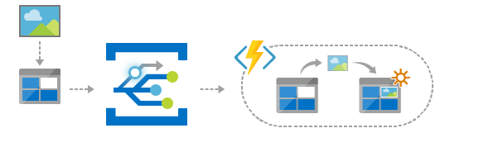
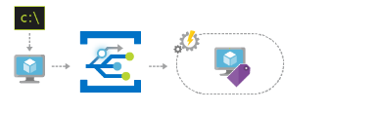
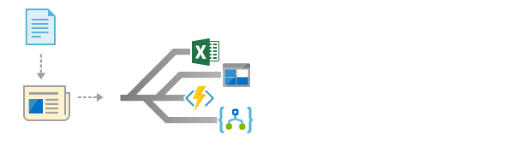
Scenarios
Serverless apps
Ops automation
Application integration
Instantly trigger a serverless function to run analysis when a new file is added to a blob storage container.
Speed up automation and simplify policy enforcement by notifying Azure Automation when underlying infrastructure is provisioned
Connects your app with other services. Create an application topic to route your app’s event data to any desired destination

Slide 26
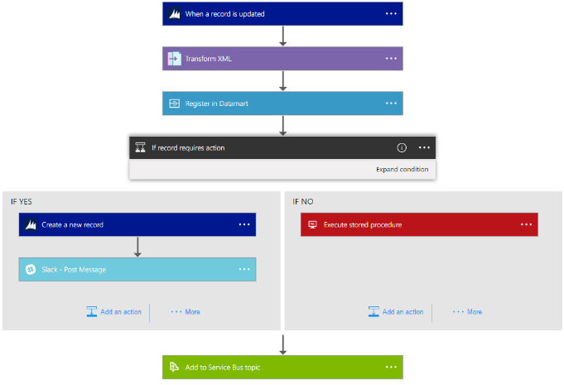
Azure Logic Apps
https://docs.microsoft.com/en-us/azure/logic-apps/logic-apps-what-are-logic-apps
Notes:
https://docs.microsoft.com/en-us/azure/logic-apps/logic-apps-what-are-logic-apps
Logic Apps helps you build, schedule, and automate processes as workflows so you can integrate apps, data, systems, and services across enterprises or organizations. Logic Apps simplifies how you design and create scalable solutions for app integration, data integration, system integration, enterprise application integration (EAI), and business-to-business (B2B) communication, whether in the cloud, on premises, or both.
For example, here are just a few workloads that you can automate with logic apps:
Process and route orders across on-premises systems and cloud services.
Move uploaded files from an FTP server to Azure Storage.
Monitor tweets for a specific subject, analyze the sentiment, and create alerts or tasks for items that need review.

Slide 27
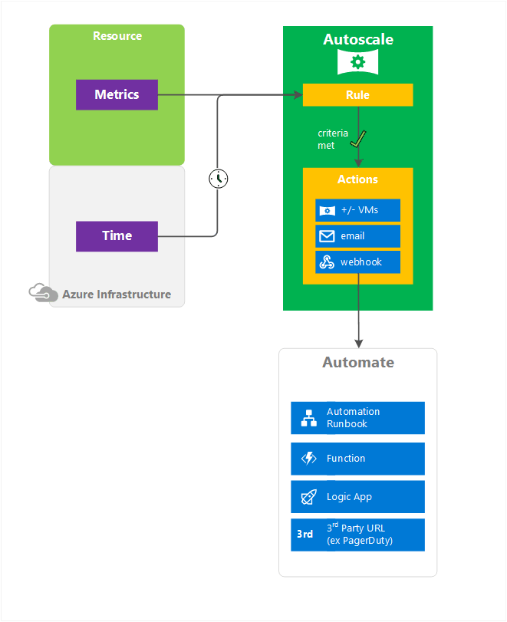
Azure Autoscale
https://azure.microsoft.com/en-us/blog/manage-your-business-needs-with-new-enhancements-in-azure-autoscale/
Notes:
https://azure.microsoft.com/en-us/blog/manage-your-business-needs-with-new-enhancements-in-azure-autoscale/
https://docs.microsoft.com/en-us/azure/monitoring-and-diagnostics/monitoring-overview-autoscale

Slide 28
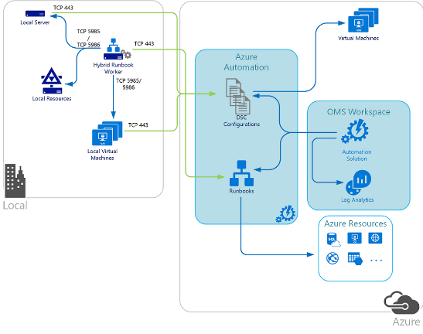
Hybrid Azure Automation - DSC
DSC configurations stored in Azure Automation can be directly applied to Azure virtual machines. Other physical and virtual machines can request configurations from the Azure Automation DSC pull server.
Note
TCP 443 from local to Azure
TCP 5985/5986 Hybrid Runbook Worker to local machines and resources
Hybrid Runbook worker is running locally and managing local resources
https://docs.microsoft.com/en-us/azure/automation/automation-offering-get-started

Slide 29
Create a standalone Azure Automation account
Create a new Automation Account from the Azure portal
https://docs.microsoft.com/en-us/azure/automation/automation-create-standalone-account

Slide 30
Thank You

Slide 31
Appendix

Slide 32
Application Insights
Detect and diagnose issues in Web apps and services
Alerts through email or webhooks
Diagnose exceptions and performance issues
Perform root cause analysis and initiate azure automation runbook
Live application monitoring
HTTP metrics, Dependency (SQL) response times, Log tracing, View and Session counts, Server performance, Availability tests
Notes:
Application Insights is an extensible Application Performance Management (APM) service for web developers on multiple platforms.
Use it to monitor your live web application. It will automatically detect performance anomalies.
It includes powerful analytics tools to help you diagnose issues and to understand what users actually do with your app.
It's designed to help you continuously improve performance and usability. It works for apps on a wide variety of platforms including .NET, Node.js and J2EE, hosted on-premises or in the cloud. It integrates with your devOps process, and has connection points to a variety of development tools.
Request rates, response times, and failure rates
Performance counters from your Windows or Linux server machines, such as CPU, memory, and network usage.
Page views and load performance - reported by your users' browsers.
Dependency rates, response times, and failure rates - Find out whether external services are slowing you down.
https://docs.microsoft.com/en-us/azure/application-insights/app-insights-overview

Slide 33
Application Map (Insights)
Notes:
The map shows:
Availability tests
Client-side component (monitored with the JavaScript SDK)
Server-side component
Dependencies of the client and server components
You can expand and collapse dependency link groups:
https://docs.microsoft.com/en-us/azure/application-insights/app-insights-app-map

Slide 34
Application Map (Insights)
Notes:
The map shows:
If you use SQL Azure, there's an icon that shows when there are recommendations on how you can improve performance.
https://docs.microsoft.com/en-us/azure/application-insights/app-insights-app-map

Slide 35
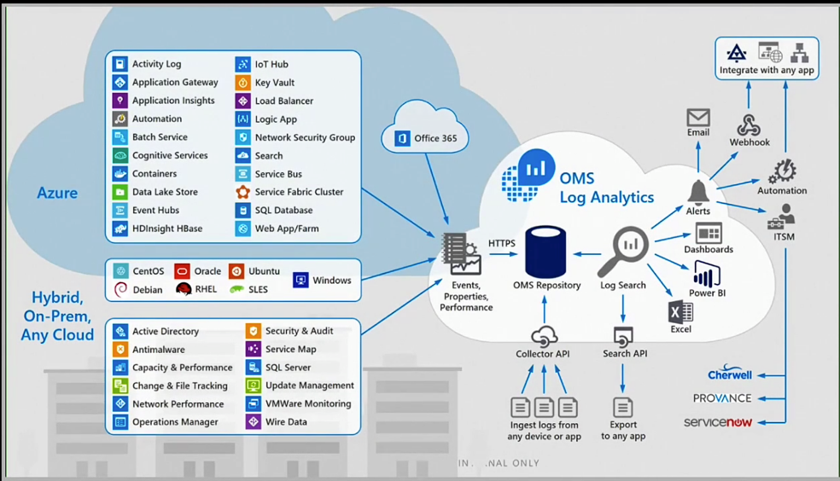
OMS Services
Notes:
The core functionality of OMS is provided by a set of services that run in Azure.
Each service provides a specific management function, and you can combine services to achieve different management scenarios
https://docs.microsoft.com/en-us/azure/operations-management-suite/operations-management-suite-overview

Slide 36
OMS Services – Log Analytics
Notes:
Log Analytics provides monitoring services for OMS by collecting data from managed resources into a central repository.
This data could include events, performance data, or custom data provided through the API.
Once collected, the data is available for alerting, analysis, and export.
This method allows you to consolidate data from a variety of sources so you can combine data from your Azure services with your existing on-premises environment.
It also clearly separates the collection of the data from the action taken on that data so that all actions are available to all kinds of data
Windows and Linux
You install the Microsoft Monitoring Agent on Windows and Linux computers or virtual machines that you want to collect data from.
Azure services. Log Analytics collects telemetry from Azure Diagnostics and Azure Monitoring into the repository so that you can monitor Azure resources.
Data Collector API. Log Analytics has a REST API for populating data from any client.
Solution Packs
AD Replication Health Solution Packs, AD Replication Solution Pack, Over network health. Tons of 3rd party tool
Views and dashboards – output
Power BI- you can export to Power BI
Log Search API. – to export to 3rd part tool
https://docs.microsoft.com/en-us/azure/operations-management-suite/operations-management-suite-overview

Slide 37
OMS Services – Process Automation
Notes:
Hybrid
Resources in your data center most likely cannot be accessed from a runbook running in the cloud.
You can install one or more Hybrid Runbook Workers (HRW) in your data center
When runbooks run in the cloud, they can access any resources accessible from the cloud.
This could be resources in your Azure subscription, in another cloud such as Amazon Web Services (AWS), or a service accessible through a REST API.
https://docs.microsoft.com/en-us/azure/operations-management-suite/operations-management-suite-overview

Slide 38
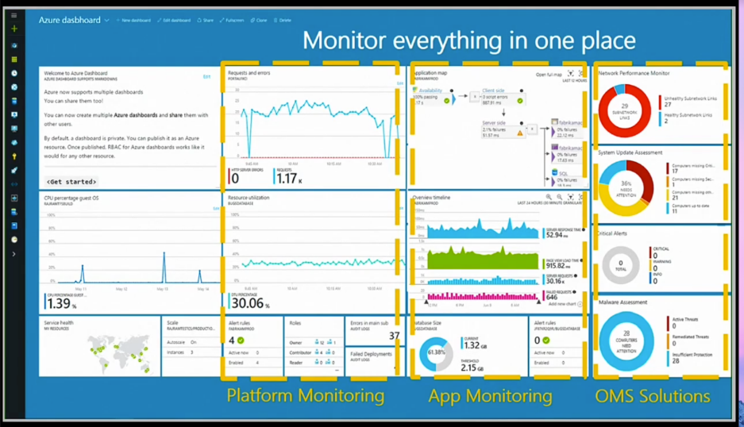
OMS Services – Security And Compliance
Notes:
Hybrid
Resources in your data center most likely cannot be accessed from a runbook running in the cloud.
You can install one or more Hybrid Runbook Workers (HRW) in your data center
When runbooks run in the cloud, they can access any resources accessible from the cloud.
This could be resources in your Azure subscription, in another cloud such as Amazon Web Services (AWS), or a service accessible through a REST API.
https://docs.microsoft.com/en-us/azure/operations-management-suite/operations-management-suite-overview

Slide 39
Azure Monitoring
Use the Azure Portal to monitor Web Apps, VMs by default.
Good Short term solution for point-in-time view
Monitoring writes data to Azure Storage
Can use Visual Studio to view
Configure Alerts from the portal based on performance metrics
Know the SLAs
Notes:
Azure Monitor provides base level infrastructure metrics and logs for most services in Microsoft Azure. Azure services that do not yet put their data into Azure Monitor will in the future.+
Microsoft ships additional products and services that provide additional monitoring capabilities for developers, DevOps, or IT Ops that also have on-premises installations. For an overview and understanding of how these different products and services work together
https://docs.microsoft.com/en-us/azure/monitoring-and-diagnostics/monitoring-overview-azure-monitor
The Service Level Agreement (SLA) describes Microsoft’s commitments for uptime and connectivity.
https://azure.microsoft.com/en-us/support/legal/sla/summary/

Slide 40
Availability Sets
Availability sets provide redundancy to your application.
Must contain the same OS and VM size
Used to configure Fault/Update domains
If using managed disks, must use a managed availability set
Notes:
In Azure, virtual machines (VMs) can be placed in to a logical grouping called an availability set.
When you create VMs within an availability set, the Azure platform distributes the placement of those VMs across the underlying infrastructure.
Should there be a planned maintenance event to the Azure platform or an underlying hardware / infrastructure fault, the use of availability sets ensures that at least one VM remains running.
https://docs.microsoft.com/en-us/azure/virtual-machines/windows/infrastructure-availability-sets-guidelines

Slide 41
Fault Domains & Update Domains
Fault domains define the group of virtual machines that share a common power source and network switch.
Update domains indicate groups of virtual machines and underlying physical hardware that can be rebooted at the same time.
Notes:
Each virtual machine in your availability set is assigned an update domain and a fault domain by the underlying Azure platform.
For a given availability set, five non-user-configurable update domains are assigned by default (Resource Manager deployments can then be increased to provide up to 20 update domains) to indicate groups of virtual machines and underlying physical hardware that can be rebooted at the same time.
When more than five virtual machines are configured within a single availability set, the sixth virtual machine is placed into the same update domain as the first virtual machine, the seventh in the same update domain as the second virtual machine, and so on.
The order of update domains being rebooted may not proceed sequentially during planned maintenance, but only one update domain is rebooted at a time.
https://docs.microsoft.com/en-us/azure/virtual-machines/windows/manage-availability#configure-multiple-virtual-machines-in-an-availability-set-for-redundancy

Slide 42
Architectural capabilities of BC/DR
You need all three
Primary site
Primary site
Secondary site
Original
Backup
DATA
DATA
High availability
Disaster recovery
Backup
When your applications have a catastrophic failure, run a second instance
When your applications have a catastrophic failure, run them in Azure or a secondary datacenter
When your data is corrupted, deleted or lost you can restore it
Notes:
Now let’s make sure we are using the same terminology for the various parts of a business continuity strategy.
HA is
DR is
Backup is
I’m going to focus on Backup and DR.

Slide 43
Architectural capabilities of BC/DR
Recovery Point Objective (RPO) and Recovery Time Objective (RTO)
Drivers of solution cost
Minimal data loss
Reduce downtime
Availability: Storage redundancy & SLAs
Blob storage: (LRS, GRS, RA-GRS), SLAs
Synchronous vs asynchronous (how data is written)
SQL Server Always On Availability Groups (replication for availability)
Network connectivity
Application connectivity post failover
IP management
Load balancers
Notes:
RPO is the amount of data that can be lost (in time)—it is the amount of time between backup, replication, or synchronization. It answers the question, “What is an acceptable amount of data loss?” It is usually much smaller than RTO.
RTO is how long it takes to restore services after a disaster. It answers the question, “How long will it take to get service back up?”

Slide 44


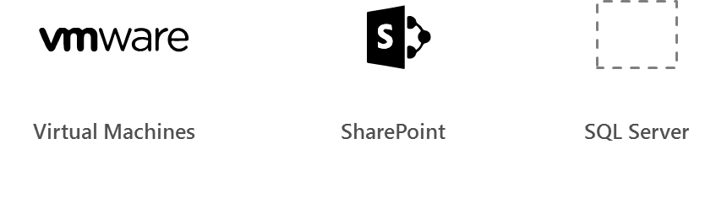
Azure Site Recovery
Azure
Automated, seamless disaster recovery from the cloud to protect applications
Provides application-consistent recovery of critical workloads
Leverage current investments
Orchestrate one-click recovery even for complex multi-tier applications
WHEN NOT
Workload requires synchronous replication, data outside of VHD
Exchange
SAP
Production Environment
SharePoint
App n
Automated
Policy-based
Orchestrated
Encrypted
VPN
ExpressRoute
Downtime
Exchange
SAP
SharePoint
App n
Production Environment
Hyper-V
Bare metal
On-premises/cloud Datacenter

Slide 45
Azure Site Recovery support matrix *
Source | Target | Availability | Supported Guest OS Types
Hyper-V 2012 R2 | Azure | Available | All Guest OS types supported by Azure
Hyper-V 2008 R2 SP1 and 2012 | Azure | Available | Windows* and Linux*
VMware vSphere 5.1, 5.5, 6.0 and Physical Servers | Azure | Available | Windows* and Linux*
Amazon Web Services (Windows AMIs) | Azure | Available | Windows Server 2008 R2 SP1+ (HVM only)
Amazon Web Services (Linux AMIs) | Azure | Available | RHEL 6.7 HVM
Hyper-V 2012 | Hyper-V 2012R2 | Available | All Guest OS types supported by Hyper-V
VMware vSphere 5.1, 5.5, 6.0 | Hyper-V 2012R2 | Available via Microsoft Services Global Delivery | Windows Server 2008 R2 SP1+
* May be asked on the exam what ASR will support for a certain scenario
Source: https://docs.microsoft.com/en-us/azure/site-recovery/
Notes:
Notes:
*Limited to Windows Server 2008 R2 SP1+, Red Hat 6.7, 7.1, 7.2, CentOS 6.5, 6.6, 6.7, 7.0+ Oracle Enterprise Linux 6.4, 6.5, SUSE Linux Enterprise Server 11 SP3
*Documentation: https://docs.microsoft.com/en-us/azure/site-recovery/
Azure VM between Azure Region is in Preview now

Slide 46
Azure BC/DR Capabilities & Use Cases
Hyper-V Replica
Simple, Affordable Second Site
“Extended Replication” + 3rd Party Integration
Hardware Agnostic – either side
Hybrid Cloud
Seamless Integration:
Private Cloud or on-premises to…
Service Provider Cloud
Microsoft Azure
Azure Site Recovery (ASR)
WHEN TO USE: 2nd Site / Use SCCM,SCVMM, Unprotected workloads
WHEN NOT TO USE:
Workload requires synchronous replication, data outside of VHD
Workload needs to recover physical servers, beyond Hyper-V replica’s capabilities

Slide 47
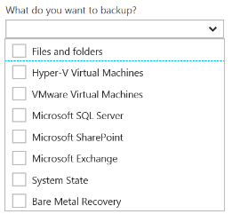
Disaster Recovery Capabilities & Use Cases
Azure Backup
Reliable, Simple, Efficient backup and restore (agent based)
Use for Branch Office or Small Business
Backup and restore files and folders
No Central Management
Azure Backup Server
Disk (D2D), giving high RTOs for tier 1 workloads
Azure (D2D2C) for long term retention
Modern Backup Storage technology (MABS v2)
VMware capabilities
Application Consistency (SQL, Exchange, SharePoint)
No Tape Backup
No Integration with System Center
Requires Azure Subscription
System Center Data Protection Manager (DPM)
Physical, VM, Azure VM
Store Locally to Disks (D2D) and to Tape (D2T)
Store in Azure (D2D2C) for long term retention
Full application consistency across server apps (Exch, SP, SQL…)
Small backup window
Bare Metal Recovery / Recovery to Azure
Full System Center Integration (discovery, reporting, etc)
StorSimple
Proprietary Device | Multiple Tiers
Cloud Integrated Storage (CiS)
Seamless view of ALL Enterprise Storage
Windows and VMWare
Multi-Tiers backup and recovery (Hot/Cold)
Fastest Solution
Long Term Azure storage; scale storage out to Azure
minimize on-premesis disk requirements
Seamless view of ALL Enterprise Storage | Windows and VMWare

Slide 48
Additional Information: SLA for Site Recovery 99.9%
"Failover" is the process of transferring control, either simulated or actual, of a Protected Instance from a primary site to a secondary site.
"On-Premises-to-Azure Failover" is the Failover of a Protected Instance from a non-Azure primary site to an Azure secondary site. Customer may designate a particular Azure datacenter as a secondary site, provided that if Failover to the designated datacenter is not possible, Microsoft may replicate to a different datacenter in the same region.
"On-Premises-to-On-Premises Failover" is the Failover of a Protected Instance from a non-Azure primary site to a non-Azure secondary site.
"Protected Instance" refers to a virtual or physical machine configured for replication by the Site Recovery Service from a primary site to a secondary site. Protected Instances are enumerated in the Protected Items tab in the Recovery Services section of the Management Portal.

Slide 49
Sharding is when you split a database and partition the different parts of the database across multiple drives. A shard is a single horizontal partition of the database.
Notes:
Large table
Just SQL Database table into small
A to D in one database
E to G in another DB
They should be pulled together
You can setup the large database per day basis or per week depending on it.
Existing application can’t be move to sharding. You will have re write the code into the application. Use different API. It is ane xtra work. For scaling point is it amazing. It is only for Relational Database. RDBMS

Slide 50
READ & Practice https://docs.microsoft.com/pdfstore/en-us/Azure.azure-documents/live/backup.pdf
Link from https://docs.microsoft.com/en-us/azure/backup/backup-try-azure-backup-in-10-mins – Download PDF

Slide 51
Azure Backup Key Workloads
Specialized Workloads
File/Folders/Volumes
Virtual Machines
Exchange
SharePoint
SQL Server
Windows Server
Windows
Windows
Linux
Hyper-V
Windows Server
Microsoft Azure
VMware
Notes:
1.
Workload: Files and folders
Source Machine: Windows Server or Windows Client
Azure Backup Solutions:
Azure Backup agent,
System Center DPM (+ the Azure Backup agent),
Azure Backup Server (includes the Azure Backup agent)
2.
Workload: Hyper-V virtual machine (Win & Linux), VMWare Virtual Machine (Win & Linux), Microsoft SQL Server, Microsoft SharePoint, Microsoft Exchange
Source Machine: Windows Server
Azure Backup Solution: System Center DPM (+ the Azure Backup agent); Azure Backup Server (includes the Azure Backup agent)
3.
Workload: Azure IaaS VMs (Windows) and Azure IaaS VMs (Linux)
Source Machine: N/A
Azure Backup Solution: Azure Backup (VM extension)

Slide 52
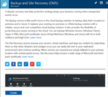
How It Works: Azure Backup Server
2. Register and configure Vault
1. Create Backup and Site Recovery Vault
3. Install Azure Backup Server software
4. Schedule & Back up encrypted data
Azure Backup Windows Server/Client
5. Recover to the same or a different server; On-Premisis or Azure VM
Step-By-Step
https://docs.microsoft.com/en-us/azure/backup/backup-try-azure-backup-in-10-mins
Notes:
Sign Up at the Azure portal
Install Azure Backup Server software
Register and configure
Back up encrypted data
Anytime the data leaves your boundary, it is encrypted. You have the passwords and keys and it’s always restored in Azure.
Recover to the same or a different server

Slide 53
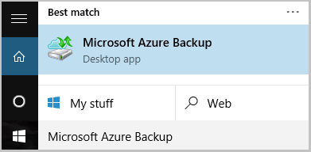
Name of the Backup agent Installer is:
MARSagentinstaller.exe
Backup Agent is
Microsoft Azure Backup
"C:\Program Files\Microsoft Azure Recovery Services Agent\bin\wabadmin.msc"
Maximum rate of backups per day?
Three (3) times per day!
Notes:
Maximum backup is 3 times per day – every 8 hours

Slide 54
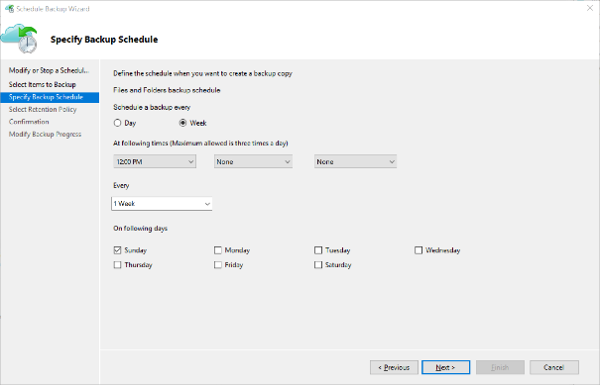
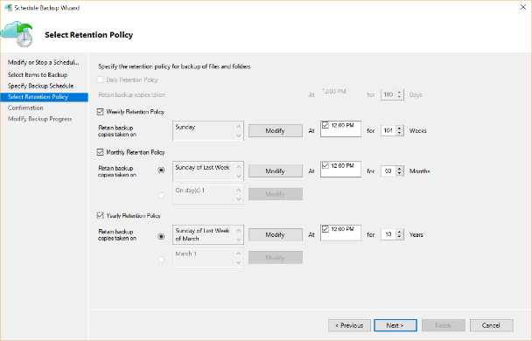
Backup Schedule & Retention Policy
Backup Schedule
Retention Policy

Slide 55
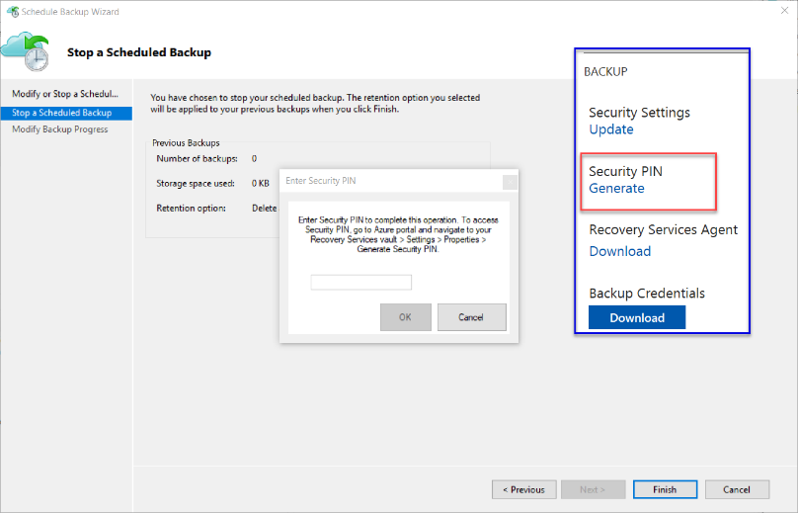
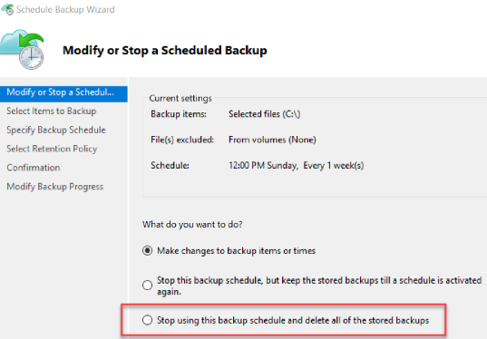
Cancelling Schedule and Removing Backups

Slide 56
Microsoft Azure Backup Server v2
Protect application workloads:
Hyper-V VMs, Microsoft SQL Server, SharePoint Server, Microsoft Exchange and Windows clients
Backup To:
Disk (D2D), giving high RTOs for tier 1 workloads
Azure (D2D2C) for long term retention
Modern Backup Storage technology (MABS v2) store backups:
Using Resilient File System (ReFS) block-cloning technology to store incremental backups,
MABS v2 significantly improves storage usage and performance.
Note: VMware is supported only in testing if Azure Backup Server is deployed on Windows 2016
Microsoft Azure Backup Server (MABS) Deployment:
physical standalone server.
Hyper-V virtual machine
Windows virtual machine in VMWare
Physical standalone server
Hyper-V virtual machine
Windows virtual machine in VMWare
An Azure virtual machine - back up cloud workloads running as Azure virtual machines.
Disks for backup storage pool: 1.5 times size of data to be protected
Docs: https://azure.microsoft.com/en-us/blog/announcing-microsoft-azure-backup-server/
Download: https://www.microsoft.com/en-us/download/details.aspx?id=55269

Slide 57
Documentation / More Info…
Azure Key Vault:
https://docs.microsoft.com/en-us/azure/key-vault/
Azure Backup:
https://docs.microsoft.com/en-us/azure/backup/

Slide 58

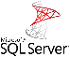

Supported workloads
How customers benefit
Infrastructure on-demand workloads
DR
Search / Data mining
Dev / Test
Cloud apps
Capacity driven workloads
Traditional on-premises workloads
File shares
Collaboration
Archives
VM workloads
SharePoint
SQL Server
Notes:
This slide is shows the alignment of different workloads with different capabilities / configurations of StorSimple solution.
For large, unstructured, capacity driven data-sets, use tiered volumes for cloud storage
For performance driven workloads – use local volumes as a local storage.
For on-demand infra requirements like DR, and dev-test, use the StorSimple Cloud Appliance
So what does all these enhancements mean for partners?

Slide 59
6.5 Describe the use cases for Azure Automation configuration
Evaluate when to use Azure Automation, Chef, Puppet, PowerShell, or Desired State Configuration (DSC)

Slide 60
Azure Automation
PowerShell & PS Workflow Engines
Use your existing PS scripts
Checkpoint/Parallel if needed
Runbooks, Modules
Author PS, PSWF, Graphical runbooks
Gallery – Runbooks, modules
Extensibility, integration
Assets
Secure, global store for variables, credentials, …
Schedules
Jobs
Troubleshoot/audit via job history
PowerShell DSC
Configurations, Pull service
Node Management & Reporting
Hybrid Runbook Workers
Install on any machine
Secure, only outbound ports
Webhooks
URL to start runbook remotely
Integration
Azure Automation
Orchestrator
Hybrid Worker
SCO
SMA
Hyper-V
VMWare
OpenStack

Slide 61
PowerShell for automation
Automating repeatable, identical tasks
Creating resources such as VMs
Tasks that are very time consuming or prone to error

Slide 62
Azure Automation Use Cases
Monitoring Configurations
Eliminate Configuration Drift
Automated Change of Configuration
Maintain Exact Configuration (override other changes)
Automated Testing
Automating Usage – Auto Start – Auto Stop
Automating Hybrid Scenarios
Automated Deployment
Implement DevOps practices
Notes:
Azure Automation is SaaS application
It automate processes with runbooks and manage configuration changes to Windows and Linux systems using Desired State Configuration (DSC) in Azure
Support other cloud services, or on-premises.
Runbooks that you run in Azure are executed on Automation sandboxes
To automate the deployment and management of resources in your local datacenter or other cloud services, after creating an Automation account, you can designate one or more machines to run the Hybrid Runbook Worker (HRW) role.
Each HRW requires the Microsoft Management Agent with a connection to a Log Analytics workspace and an Automation account.
Log Analytics is used to bootstrap the installation, maintain the Microsoft Management Agent, and monitor the functionality of the HRW.
The delivery of runbooks and the instruction to run them are performed by Azure Automation.
You can deploy multiple HRW to provide high availability for your runbooks, load balance runbook jobs,
and in some cases dedicate them for particular workloads or environments.

